Slide 1
CS 4530: Fundamentals of Software Engineering Module 8: Patterns of React
Adeel Bhutta, Jan Vitek and Mitch Wand
Khoury College of Computer Sciences
© 2023 Released under the CC BY-SA license

Slide 2
Learning Objectives for this Lesson
By the end of this lesson, you should be able to:
Recognize and apply four common patterns in functional React components (useState, useEffect, useCustomHook, useContext)
Understand how React functional components allow behaviors to be reused

Slide 3

Review: React Components Should be Reusable
Organize related logic and presentation into a single unit
Includes necessary state and the logic for updating this state
Includes presentation for rendering this state into HTML
Example: “Like” button
What does the button keep track of?
Is it liked or not, What post this is associated with
What logic does the button have?
When changing like status, send update to server
How does the button look?
Filled in if liked, hollow if not

Slide 4
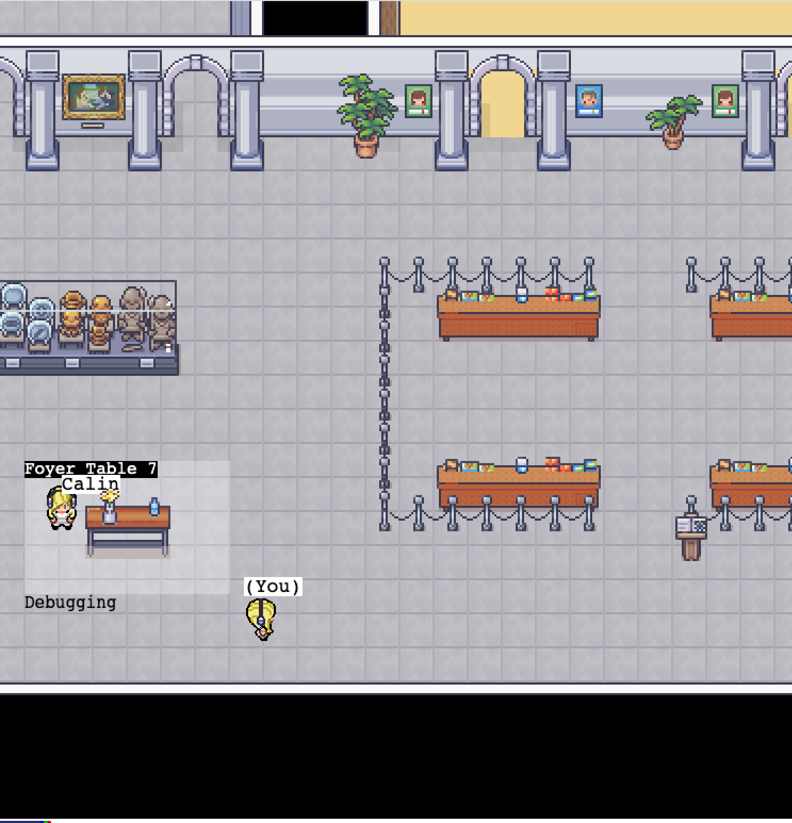
Motivation: React Component Behaviors Should be Reusable
Idea: Component behavior is often reused even without reusing the same presentation (UI)
Example, Covey.Town frontend: “Show the players in the current video call”
Multiple UI components might want to render this (and auto-update in real-time)
CoveyTownController has the list of players, their locations, emits events when players change
How to implement this behavior (“retrieve the current players in video call, automatically re-render when changes) in a reusable way?

Slide 5
React “Hooks” Solve Common Problems
How to keep track of state that can be re-used across multiple renders?
How to define some aspects of our component that should change when some data changes?
How to share data from one component to many, without passing lots of props?
Broadly: How to define common behaviors that can be reused by other components?
Notes:
“Hook” -> hooks into react framework

Slide 6
Pattern: useState Tracks Mutable State
Context: React components are just functions, called on each render.
Problem 1: How to keep track of state that can be re-used across multiple renders?
Problem 2: How to tell React that state has changed, so component should re-render?
Problem 1 - where to store this?
Problem 2 - How to tell React?
export function LikeButton(){
if (isLiked) {
return (<IconButton aria-label="unlike"
icon={<AiFillHeart />} onClick={() => setIsLiked(false)} /> );
} else {
return (<IconButton aria-label="like"
icon={<AiOutlineHeart />} onClick={() => setIsLiked(true)} /> );
}
}
Notes:
useState is the first React Hook that we will discuss. We used this hook in the last module to discuss the difference between “properties” and “state”. The “useState” hook is used to create and access a state variable. Let’s see why useState is necessary, and how it solves the problem of implementing the idea of “state” in React.
Recall from the last module that “state” in react components are data that can change during a component’s lifetime, and when it changes, React re-renders the component to reflect that change. In the “instagram like button” example, the fact that a post was (or was not) liked was state.
(Read slide)
(Click to show builds pointing to isLiked and setIsLiked) - The problem that needs to be solved is: how to store and retrieve our state variable to reuse between multiple calls to LikeButton, how to tell react that we want to change the value and that, in turn, react should re-render the component?

Slide 7
useState Tracks Mutable State
const [state, setState] = useState<TypeOfState>(initialValue);
useState returns an array of length 2: the first value is the current state value, second is a setter we can call to update that value. React doesn’t know or care what names you choose here (var, setVar are convention though!)
<TypeOfState> is an optional generic type parameter to declare the type of state
initialValue is the value that state should take before the first call to setState
export function LikeButton(){
const [isLiked, setIsLiked] = useState(false);
if (isLiked) {
return (<IconButton aria-label="unlike"
icon={<AiFillHeart />} onClick={() => setIsLiked(false)} /> );
} else {
return (<IconButton aria-label="like"
icon={<AiOutlineHeart />} onClick={() => setIsLiked(true)} /> );
}
}
Notes:
(Read the signature of setState and the captions explaining the return, type, and initial value). Note that the syntax [state, setState] = useState is shorthand syntax that means “take the first element in the array returned by useState and assign it to state, and the second, assign that to setState” - this is not specific to useState, and you can use this syntax elsewhere.
With this more clear definition of useState, let’s revisit how to store and update the state of our “like” button. We declare our state variable isLiked, and the setter for it. The initial value for the button is “false” - not liked. In a slightly more realistic example, we might initialize the state of the button to match something that is stored on some server or database. When we provide an initial value for the state, we can let typescript automatically infer the type of the state variable (to be the same as the type of the initial value) - that’s why in this example we don’t declare that isLiked is a “boolean” (cool!)

Slide 8
useState should be called once per-state variable
To have multiple state variables, call useState for each one
Example: Track how many times the “like” button has been clicked
export function LikeButton(){
const [isLiked, setIsLiked] = useState(false);
const [count, setCount] = useState(0);
if (isLiked) {
return (<IconButton aria-label="unlike"
icon={<AiFillHeart />} onClick={() => setIsLiked(false)} /> );
} else {
return (<IconButton aria-label="like" icon={<AiOutlineHeart />} onClick={() => {
setCount(count + 1)
setIsLiked(true)
}} /> );
}
}
Notes:
(Read the signature of setState and the captions explaining the return, type, and initial value). Note that the syntax [state, setState] = useState is shorthand syntax that means “take the first element in the array returned by useState and assign it to state, and the second, assign that to setState” - this is not specific to useState, and you can use this syntax elsewhere.
With this more clear definition of useState, let’s revisit how to store and update the state of our “like” button. We declare our state variable isLiked, and the setter for it. The initial value for the button is “false” - not liked. In a slightly more realistic example, we might initialize the state of the button to match something that is stored on some server or database. When we provide an initial value for the state, we can let typescript automatically infer the type of the state variable (to be the same as the type of the initial value) - that’s why in this example we don’t declare that isLiked is a “boolean” (cool!)

Slide 9
State Setters are Asynchronous
Recall from Module 7: React uses a carefully optimized approach to (re)-render components
Components are not re-rendered immediately upon calling a state setter
export function LikeButton(){
const [isLiked, setIsLiked] = useState(false);
const [count, setCount] = useState(0);
if (isLiked) {
...
} else {
return (<IconButton aria-label="like" icon={<AiOutlineHeart />} onClick={() => {
console.log(`Pre-setCount, count=${count}`)
setCount(count + 1)
setIsLiked(true)
console.log(`Post-setCount, count=${count}`)
}} /> );
}
}
Output:
(Click like) 1. Pre-setCount, count=0 2. Post-setCount, count=0
Notes:
(Read top 2 bullets)
For reasons that are very related to the “run-to-completion” semantics of javascript, component re-renders are batched together and performed asynchronously.
We’ve annotated the like button example with some console.log statements to illustrate this behavior.
(Click to show output)
When this component is rendered the first time, it will show “Likebutton rendered isLiked=false”. Upon clicking on the “like” button, we’ll see the call to setIsLiked, then the return from setIsLiked, but the isLiked variable has not yet been updated.
Shortly after, React will re-render the component (calling this function again), printing out the message “LikebuttonRendered isLiked=true”.
The key implication of “state setters are asynchronous” is that your component’s logic should not assume that the state variable is set immediately - if you have some logic that should occur as a *side effect* of the state variable being updated, then this is best performed using a different hook - useEffect

Slide 10
Pattern: useEffect Invokes Side-Effects after rendering
Context: React components are just functions, called on each render.
Problem: How to define side-effects that run in response to data changing (and in turn, the component re-rendering)?
Pattern: React’s useEffect hook
useEffect(()=>{
// Code that runs after each render
return () => {
// Code that runs after the component is removed from the page OR before hook runs again
}
})
Notes:
If we would like to invoke some side effect after a component renders with React, we use the “useEffect” hook. “useEffect” solve the common problem of defining side-effects that run in response to data changing (and in turn, re-rendering).
useEffect is a function provided by React that takes, as a parameter, a callback function. That callback function is invoked each time that the component re-renders.
The function passed to useEffect can (optionally) return another function, which is called to cleanup any side-effects that the useEffect might have performed, like creating event listeners that should be removed.

Slide 11
useEffect Invokes Side-Effects after rendering
React’s useEffect hook accepts a function that is always called after the component is updated
export function LikeButton(){
const [isLiked, setIsLiked] = useState(false);
const [count, setCount] = useState(0);
useEffect(()=>{
console.log(`Like has been clicked ${count} times`)
})
if (isLiked) {
return (<IconButton aria-label="unlike"
icon={<AiFillHeart />} onClick={() => setIsLiked(false)} /> );
} else {
return (<IconButton aria-label="like" icon={<AiOutlineHeart />}
onClick={() => {
console.log(`Pre-setCount, count=${count}`)
setCount(count + 1)
setIsLiked(true)
console.log(`Post-setCount, count=${count}`)
}} /> );
}
}
Output:
Like has been clicked 0 times
(Click like) 1. Pre-setCount, count=0 2. Post-setCount, count=0 Like has been clicked 1 times
(Click un-like) Like has been clicked 1 times
(Click like)
Like has been clicked 2 times
(Click un-like)
Like has been clicked 2 times
Notes:
Continuing this example: if we would like to print out how many times the “like” button was clicked, we can create a useEffect hook for this.
(Click to show output on right)
This useEffect will be triggered each time that the component re-renders, and hence, it will print out the correct number of times that “like” has been clicked.
However, there is one more important feature of useEffect that we need to introduce - this effect happens on EVERY re-render of the component. As we run this code in the browser and keep clicking on the button toggling it between like and unlike (click to show additional output), we might notice that “Like has been clicked X times” is printed out not only when the “like” button is clicked, but also when the “unlike” button is clicked. This is because React re-renders the component in response to state changes, and runs our side-effect as a result of re-rendering. Setting “isLiked” to false is a state change, and hence, the effect runs.
What if we only wanted to print the number of times like is pressed when it changes, and not whenever the component re-renders?

Slide 12
useEffect Dependencies Limit Their Execution
useEffect takes an optional array of dependencies
The effect is only executed if the values in the dependency array change (by reference equality)
useEffect(()=>{
// Code that runs after each render
return () => {
// Code that runs after the component is removed from the page OR before hook runs again
}
})
useEffect(()=>{
// Code that runs after each render if dependency or anotherDependency change
return () => {
// Code that runs after the component is removed from the page OR before hook runs again
}
}, [dependency, anotherDependency])
Only run the effect if dependency or anotherDependency change to point to a different thing
useEffect(()=>{
// Code that runs after each render if dependency or anotherDependency change
}, [])
Only run the effect on the very first render
Notes:
The useEffect hook also takes an array of dependencies. If an array is provided, then React will only call our effect if any of the values in that dependency array change. React uses simple reference equality to check for changes - so changing an object property on one of those dependencies won’t trigger an execution; pushing elements into an array won’t trigger it either. This will only be triggered if the variable `dependency` or `anotherDependency` point to something new than they did on a prior render.
(Click) As a special case, passing an empty dependency array means that the side-effect should run only on the very first render (and cleanup only when the component is removed from the page)

Slide 13
useEffect Dependencies Limit Their Execution
If we add “count” to the dependencies array, then the effect is only executed when the value of “count” changes
export function LikeButton(){
const [isLiked, setIsLiked] = useState(false);
const [count, setCount] = useState(0);
useEffect(()=>{
console.log(`Like has been clicked ${count} times`)
}, [count])
if (isLiked) {
return (<IconButton aria-label="unlike"
icon={<AiFillHeart />} onClick={() => setIsLiked(false)} /> );
} else {
return (<IconButton aria-label="like" icon={<AiOutlineHeart />}
onClick={() => {
console.log(`Pre-setCount, count=${count}`)
setCount(count + 1)
setIsLiked(true)
console.log(`Post-setCount, count=${count}`)
}} /> );
}
}
Output:
Like has been clicked 0 times
(Click like) 1. Pre-setCount, count=0 2. Post-setCount, count=0 Like has been clicked 1 times
(Click un-like)
(Click like)
Like has been clicked 2 times
(Click un-like)
Notes:
Returning to our LikeButton example: by specifying “count” as a dependency for our effect, it will now only be triggered when the value of “count” changes, which will only happen when “isLiked” is set to true.
Now, when we run this component (click to show output), we can see that even when we click the “un-like” button, the effect does not run - it only runs when the value of count changes, which in turn, only changes when we click the “like” button
This component does what we hoped: it tracks how many times “like” was clicked, and prints out when that value changes.
However, from a design principles standpoint, it’s a mess. The “onClick” handler for “like” has multiple responsibilities: it sets the count, AND it sets liked. This is a violation of the single responsibility principle: why does the “like” button need to encode the knowledge of how the “count likes” functionality works? What if we had other ways to trigger changes to the “isLiked” variable? For example: we might want to have multiple ways to trigger the “like” button - perhaps there are multiple actual buttons, or we have keyboard triggers, etc.
A better design would decouple “count how many times isLiked was set to true” from “how to set isLiked”. Thankfully, the patterns of useEffect and useState can be used to achieve that de-coupling.

Slide 14
useEffect + useState: Maintaining state for side-effects
An extremely common pattern is to combine useEffect and useState
Often requires using a “state updater” instead of concrete value
export function LikeButton(){
const [isLiked, setIsLiked] = useState(false);
const [count, setCount] = useState(0);
useEffect(()=>{
if(isLiked){
setCount((prevCount) => prevCount + 1)
}
}, [isLiked])
useEffect(()=>{
console.log(`Like has been clicked ${count + 1} times`)
}, [count])
if (isLiked) {
return <IconButton aria-label="unlike" icon={<AiFillHeart />} onClick={() => setIsLiked(false)} />;
} else {
return <IconButton aria-label="like" icon={<AiOutlineHeart />} onClick={() => setIsLiked(true)} />;
}
}
Alternate call pattern for state setter: pass a function that returns the new state based on the old state
Run this effect only when isLiked changes
Run this effect only when count changes
Notes:
This version of the LikeButton moves the responsibility for updating the count variable to a new useEffect (click to show first hint), which is dependent on isLiked - it will be triggered each time that isLiked changes. Within that effect, we check to see if the “new” value of isLiked is true, and if so, we update the count.
(Click to show second hint) To set the count, we need to know the current value of the count, so that we can increment it. However, we will see that there is a linting error (and a bug!) if we tried to use the value `count` in our effect, unless we added `count` as a dependency for the effect. However, if we added `count` as a dependency on the hook, we would have an infinite loop: we would set the count to the new count, then our effect would be triggered again because the count changed.
Instead, we will NOT reference the “count” at all in our effect, and will use an alternate call pattern for setting state in react. As shown here, instead of passing a concrete value (E.g. count+1), we can pass a function to the state setter, which is called by react asynchronously, when it is about to re-render the component. This function is passed the current value of the state variable, allowing it to compute a new state value based on the old one. This way, we can avoid needing to reference “count” in this effect, and avoid the circular dependency when updating it.
(Click to show last hint)
To print out the number of times that like has been clicked, we still use an useEffect with the “count” as its dependency.
This design removes the responsibility for managing the “count” variable from the click handler for the “like” button. However, we can push the design even further. We motivated the idea of hooks as: “How to reuse component BEHAVIOR?” Keeping track of how many times some boolean value was changed to true might be the kind of behavior that we want to package up so that it can be re-used. What if we wanted to track how many times other activities happened?

Slide 15
Pattern: use<HookName> For Custom Hooks
Problem: How to compose and reuse “behaviors” that might involve storing state and performing side-effects?
Solution: Create a “custom hook” - a function that starts with “use” and calls other hooks
By convention, all custom React hooks should start with the prefix “use”
Notes:
The general pattern that we’ll look at here is: writing custom hooks.
What do we do when we have some behaviors that we want to re-use across our application? In the example that we are in the middle of, we want to keep track of how many times a boolean variable was set to true, and print out to the console when that count changes. A more complex example of this problem is: “How do we create many react components that show a representation of the same data, and update in response to the different ways that this data might change?”
The solution is to create a custom hook.
React hooks can be used in any react component, OR in any custom hook. You can write a new react hook simply by creating a function that starts with the prefix “use”, and can then use this hook.
By convention, all custom react hooks should start with the prefix “use”

Slide 16
use<HookName>: Write Custom Hooks
Calls to multiple hooks can be composed into a “custom” hook
By convention, all custom React hooks should start with the prefix “use”
export function useLogCountOfProp(propertyName: string, propertyValue: boolean){
const [count, setCount] = useState(0);
useEffect(()=>{
if(propertyValue){
setCount((prevCount) => prevCount + 1)
}
}, [propertyValue])
useEffect(()=>{
console.log(`Property ${propertyName} was set to true ${count} times`);
}, [count, propertyName])
}
export function LikeButton(){
const [isLiked, setIsLiked] = useState(false);
useLogCountOfProp('isLiked', isLiked);
// No 'count' here, just the original like button }
Notes:
For example: we can create a new hook called “useLogCountOfProp” - this hook will take two parameters: the name of the property that we want to log, and its current value.
Our custom hook looks quite a bit like what we had embedded in the LikeButton directly: we have a state variable called ‘count’, a useEffect to update that count when the propertyValue changes, and a useEffect to print out the current count when it changes.
By using this pattern (of creating a custom hook), we can reuse this functionality in other components without needing to copy/paste it. As another benefit, we can group all of the related functionality into one (well-named) method. Rather than having the implementation of the logging code embedded within our LikeButton, it is abstracted away and stored in another (hopefully documented) method. This hides the implementation details from the client class, and hopefully makes it easier to understand what the client code does.

Slide 17
Pattern: useContext and Passing State
Problem: Applications often some data that changes very infrequently, and is needed by many components. Passing that data as properties is cumbersome
Example: Covey.Town’s frontend has a TownController. Any component that needs to access data about the town needs a reference to it
export function CoveyTown(){
const [townController, setTownController] = useState<TownController>();
if(townController){ //Logged in
return <TownMap townController={townController} />
}
return <Login />
}
export function TownMap(props: {townController: TownController}){
return <div>
<NewConversationModal townController={props.townController} />
<SocialSidebar townController={props.townController} />
</div>
}
Global state: once we are logged in, every component will need this
We need to pass this to EVERY component!?
Notes:
Compared to useState and useEffect, it is unlikely that you will often write code that uses the useContext hook directly. However, it is important to understand the problem that it solves, and how to recognize when it’s needed.
The general problem that useContext solves is passing state that is needed by many components. (Read slide)
The reason why this becomes a particular problem is that It’s *very* cumbersome to have to use properties to to pass this state to every component that needs it.
(Click to show code snippet)
In the Covey.Town frontend application, the TownController tracks all of the information about the current town that the player is connected to, and manages all communication with the backend townService and other players.
(Click to show first highlight) The TownController is global state here: once the player logs in, many components might need it: anything that displays data about the town!
The only way that we know so far to pass this global state to other components is as a property. (Click to show second highlight). Every single component that either uses the TownController, or has a child that needs to use the TownController will need to have the townController passed as a property. This is cumbersome: what happens if we need to add some new global variable? What if we have some component in-between that we didn’t write, and doesn’t know to pass our special property through?
This is the problem that useContext solves.

Slide 18
useContext Accesses Shared State
React.createContext creates a “context” - a pointer to shared state
A provider for that context sets the value
useContext returns the current value for that context
A custom hook makes it easy for client components to access the shared value
export const TownControllerContext = React.createContext<TownController | null>(null);
export function CoveyTown(){
const [townController, setTownController] = useState<TownController>();
if(townController){ //Logged in
return (<TownControllerContext.Provider value={townController}>
<TownMap />
</TownControllerContext.Provider>)
}
return <Login />
}
export default function useTownController(): TownController {
const ctx = useContext(TownControllerContext);
assert(ctx, 'TownController context should be defined in order to use this hook.');
return ctx;
}
Create a context to store our shared state
Shared state: Every component nested within the provider can access
This hook will always return the TownController
Notes:
The “useContext” pattern in react addresses this problem. There are three steps for using it.
(Click to show hint1) First, we use the method React.createContex to create a new context to store our shared state. This does not set the value or make it available, but is needed to tell React to allocate some pointer to our shared state that we will later set.
(Click to show hint2) Then, we create a “Provider” for that context, setting its value property to our shared value. Note that this is different from the (non-context) version that we saw on the last slide, because we only need to pass this property *once*. This provider will provide the value for this context to every component that is nested within it (e.g. any child component of TownMap)
(Click to show hint 3) Then, we can use the “useContext” hook to access the current value of the context. Typically, we create a custom hook to call useContext with the intended context, abstracting the entire notion of “context” from client code. This way, client code can simply call “useTownController” and get a pointer to the current town controller.

Slide 19
React Functional Components are More Modular than Class Components
Functional components
Create a useEffect for each behavior
Each useEffect can have its own cleanup callback
Compose multiple hooks into custom hooks for reusable behaviors
Class components
Implement side-effects in componentDidMount, componentDidUpdate, componentWillUnmount
Each side-effect is spread between all three methods
All side-effects are mixed together
Can not easily reuse effects between components
Notes:
In the last module, we mentioned that there is another pattern that can be used to create components in react: components can be specified as classes instead of as functions. Here is a brief comparison of the two approaches when it comes to side-effects and state.
As we’ve seen in the past few slides, useState and useEffect are powerful abstractions that allow us to compose and reuse behaviors. useEffect organizes our side-effects around their behaviors - we can create as many useEffects as we need to organize our abstractions.
With class-based components, each side effect is implemented in up to three methods of each component: componentDidMount, componentDidUpdate and componentWillUnmount. This means makes it more difficult to keep related code together.

Slide 20
The Rules of Hooks
Hooks are APIs provided by React that let components “hook” into React’s internal behavior
Each time that a component is rendered, the hooks will be called again
React be able to correlate the same calls to the same hook, e.g. to differentiate between two useState calls
The rules of hooks ensure consistent behavior
export function LikeButton(){
const [isLiked, setIsLiked] = useState(false);
const [count, setCount] = useState(0);
...
}
How does React keep track of which state variable is which? (The Rules of Hooks say how)
Notes:
The nice things that we can get with functional react components and hooks are possible only if we write code that conforms to React’s expectation - we must follow the Rules of hooks.
(Read slide)

Slide 21
The Rules of Hooks
Only call hooks at the top level
Not within loops, inside conditions, or nested functions
Rationale: The order of hooks called must always be the same each time a component renders
Only call hooks from React Components or Custom Hooks
Not from any other helper methods or classes
Rationale: React must know the component that the call to the hook is associated with
export function LikeButton(){
const [isLiked, setIsLiked] = useState(false);
const [count, setCount] = useState(0);
...
}
React knows which useState is which by tracking calls to them from components in the render tree
Notes:
There are two rules of hooks, both of which are necessary for React to uniquely identify calls to hooks across different renders of the same component.
(Read slide)

Slide 22
We Use Two ESLint Rules for React Hooks
You should not violate the rules of hooks. These linter plugins help detect violations
React-hooks/rules-of-hooks
Enforces that hooks are only called from React functional components or custom hooks
React-hooks/exhaustive-deps
Enforces that all variables used in useEffects are included as dependencies

Slide 23
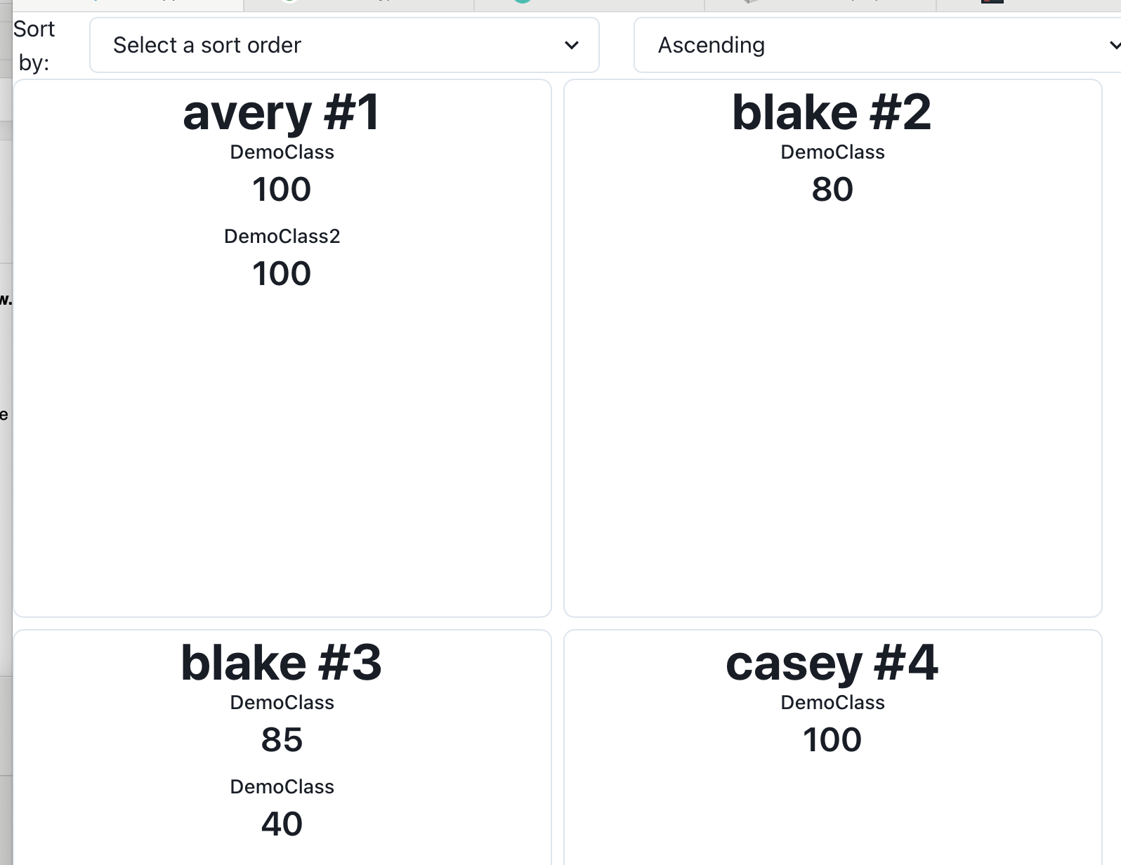
A Bigger Example: Transcript App
Fetches student transcripts from our REST API
Uses useEffect to fetch data when page is first loaded
Stores transcripts as state in component
Has not yet fully implemented “edit” or “add” functionality

Slide 24
Review
Now that you've studied this lesson, you should be able to:
Recognize and apply four common patterns in functional React components (useState, useEffect, useCustomHook, useContext)
Understand how React functional components allow behaviors to be reused

